Slide 1
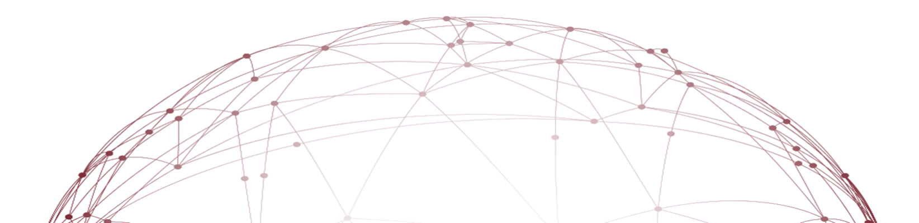
Fake News Propagation and Detection: A Sequential Model
苏啸宇 2022214320
上海财经大学

Slide 2
01
Introduction
02
Related Literature
03
Basic model description
04
The Agents’News-Sharing Process
05
The Platform’s Inspection Problem
06
The Impact of Fake News on Agent Opinions
07
Conclusion

Slide 3
Introduction
Background
Fake news played an important role in determining the 2016 U.S. presidential election.
The platforms that facilitate the sharing of fake news such as Twitter are blamed.
Social media’s action
Preventive: Curb the production of fake news
Corrective: Detect and remove fake news already in circulation

Slide 4
Introduction
Our target
Develop the optimal policy of inspecting fake news for the platform
Measure fake news’impact on society’s learning environment
Sequential Model
A sequence of agents receive a news article of unknown validity
The agent needs to choose whether to conduct a costly inspection
The agent then needs to decide whether to share the article

Slide 5
01
Introduction
02
Related Literature
03
Basic model description
04
The Agents’News-Sharing Process
05
The Platform’s Inspection Problem
06
The Impact of Fake News on Agent Opinions
07
Conclusion

Slide 6
Related Literature
Sequential decision paradigm
Banerjee (1992)and Bikhchandanietal.(1992):The agent will take an action related to the unobservable state of the world after observing the actions of her predecessors
Acemoglu et al. (2011)and Drakopoulosetal.(2013):Agent can observe only a subset of her predecessors.
Sequential decision making often leads to inefficient outcomes
Veeraraghavan and Debo (2009): customers may choose a inferior server after observing their predecessors

Slide 7
Related Literature
Social learning for operational decisions
Yu et al. (2015), Papanastasiou and Savva (2016), Crapis et al. (2017), and Shin and Zeevi (2017)：The impact of consumer reviews on optimal pricing policies
Feldman et al. (2018)：The presence of social learning may lead to a decrease in the quality of new experience goods
Broader defined effects of social interactions
Candogan et al. (2012):Optimal pricing policies when consumers embedded in a social-network experience local consumption externalities
Manshadi and Misra (2016):New product diffusion in networks with limited social interactions
Hu et al. (2015):The effects of social influence on optimal inventory decisions

Slide 8
Related Literature
Operations of online service platforms
Marinesi et al. (2018):The operational advantages of threshold discounting offers
Gao and Su (2017) ：Consider whether a retailer benefits by providing consumers the option to buy online and pick up in store
Papanastasiou et al. (2018):Study optimal information disclosure with the goal of promoting exploration in an online review platform
The effects of fake-news
Vosoughi et al. (2018):Fake news tends to diffuse farther and faster than truthful news
Jun et al. (2017):Subjects were less likely to fact-check claims when the claims were evaluated in the presence of others;
Qiu et al. (2017):Highlight the role of behavioral limitations in the prevalence of low-quality information in a social network.

Slide 9
01
Introduction
02
Related Literature
03
Basic model description
04
The Agents’News-Sharing Process
05
The Platform’s Inspection Problem
06
The Impact of Fake News on Agent Opinions
07
Conclusion

Slide 10
Basic model description
Notations
θ ∈{T, C}:An unobservable binary state of the world
(m,a):The observable pair of the contents of the article
m ∈{“T”, “C”} is the state realization that the information contained in the article supports.
a ∈(0.5, 1) is the persuasiveness of the information when this is taken at face value.

Slide 11
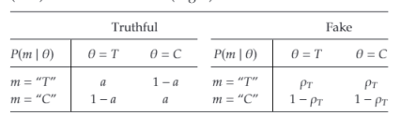
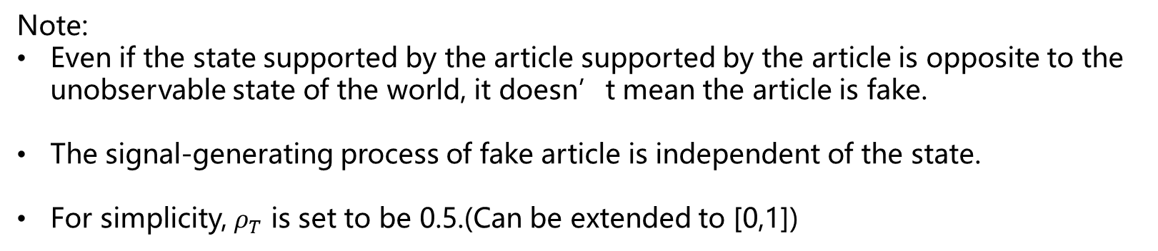
Basic model description
The Signal-Generating Process
Note:
Even if the state supported by the article supported by the article is opposite to the unobservable state of the world, it doesn’t mean the article is fake.
The signal-generating process of fake article is independent of the state.
For simplicity, $ρ_{T}$ is set to be 0.5.(Can be extended to [0,1])

Slide 12
Basic model description
An example
Topic :Whether the burning of fossil fuels is linked to climate change.
Article :UC Berkeley study finds no connection between climate change and the burning of fossil fuels.
Explanation
The unobservable state θ ∈{Y, N}, where Y means there is a link between the burning of fossil fuels and climate change and N means there is no link.
The pair of the article (m, a)=(“N”, 0.95), because the article’s content supports θ=N and the result of UC Berkeley is more persuasive. And that means a=P(m=“N”| θ=N)=0.95]

Slide 13
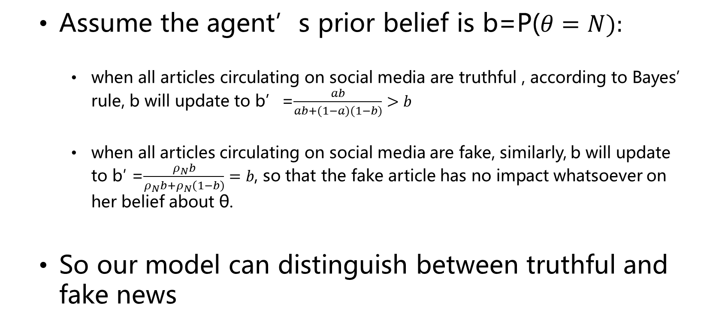
Basic model description
Assume the agent’s prior belief is b=P($θ=N):$
when all articles circulating on social media are truthful , according to Bayes’ rule, b will update to b’=$\frac{ab}{ab+(1−a)(1−b)}>b$
when all articles circulating on social media are fake, similarly, b will update to b′ =$\frac{ρ_{N}b}{ρ_{N}b+ρ_{N}\left(1−b\right)}=b$, so that the fake article has no impact whatsoever on her belief about θ.
So our model can distinguish between truthful and fake news

Slide 14
01
Introduction
02
Related Literature
03
Basic model description
04
The Agents’News-Sharing Process
05
The Platform’s Inspection Problem
06
The Impact of Fake News on Agent Opinions
07
Conclusion

Slide 15
The Agents’News-Sharing Process
Basic assumptions
Only focus on the underlying state of T , and a news article is generated that claims to be informative with respect to the true underlying state.
There exists an infinite number of agents, who take actions in sequence over a discrete time horizon indexed by t ∈{1, 2, ...}.
Agent can only share the article to another agent (Apply to the situation of more agents)
Agent will not share the article if she knows the article is fake.
Each agent’s opinion is an independent and identically distributed draw from a distribution with cumulative distribution function F(·).
Each agent receiving the article knows the number of times the article has been previously shared, but not how many times the article has undergone inspection by the preceding agents, or the private opinions of the preceding agents.

Slide 16
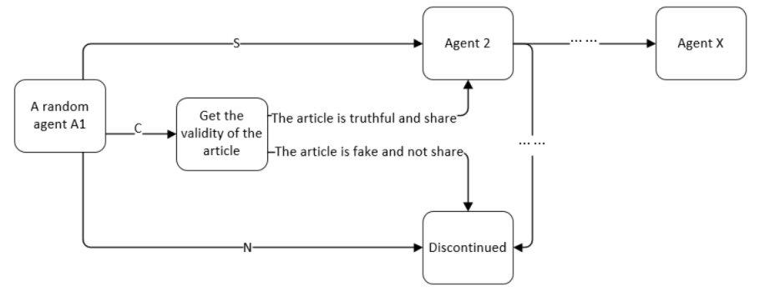
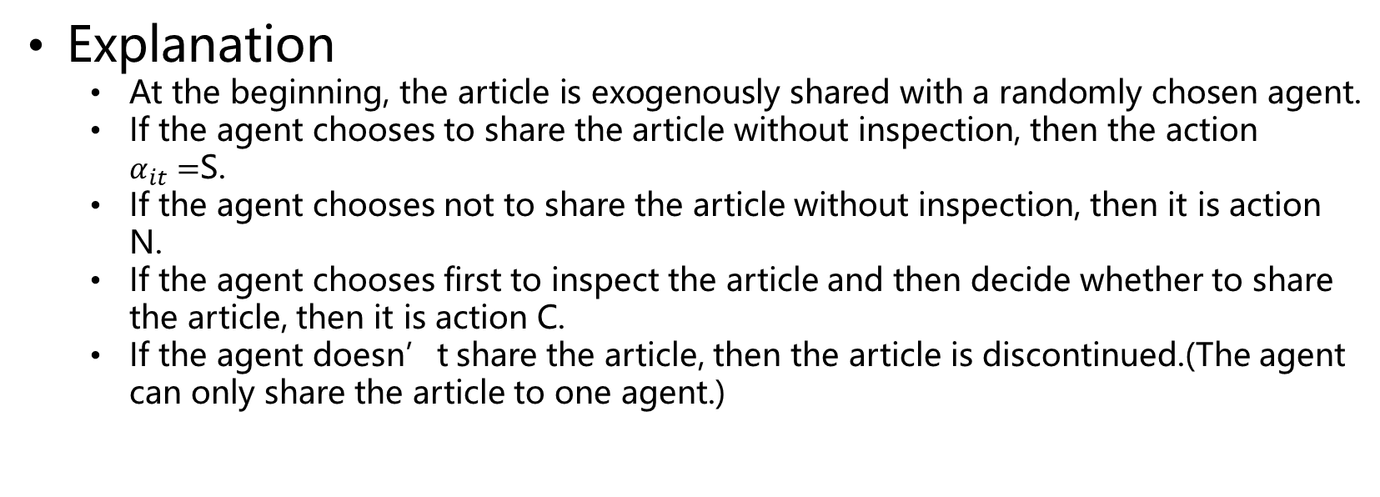
The Agents’News-Sharing Process
Explanation
At the beginning, the article is exogenously shared with a randomly chosen agent.
If the agent chooses to share the article without inspection, then the action $α_{it}=$S.
If the agent chooses not to share the article without inspection, then it is action N.
If the agent chooses first to inspect the article and then decide whether to share the article, then it is action C.
If the agent doesn’t share the article, then the article is discontinued.(The agent can only share the article to one agent.)

Slide 17
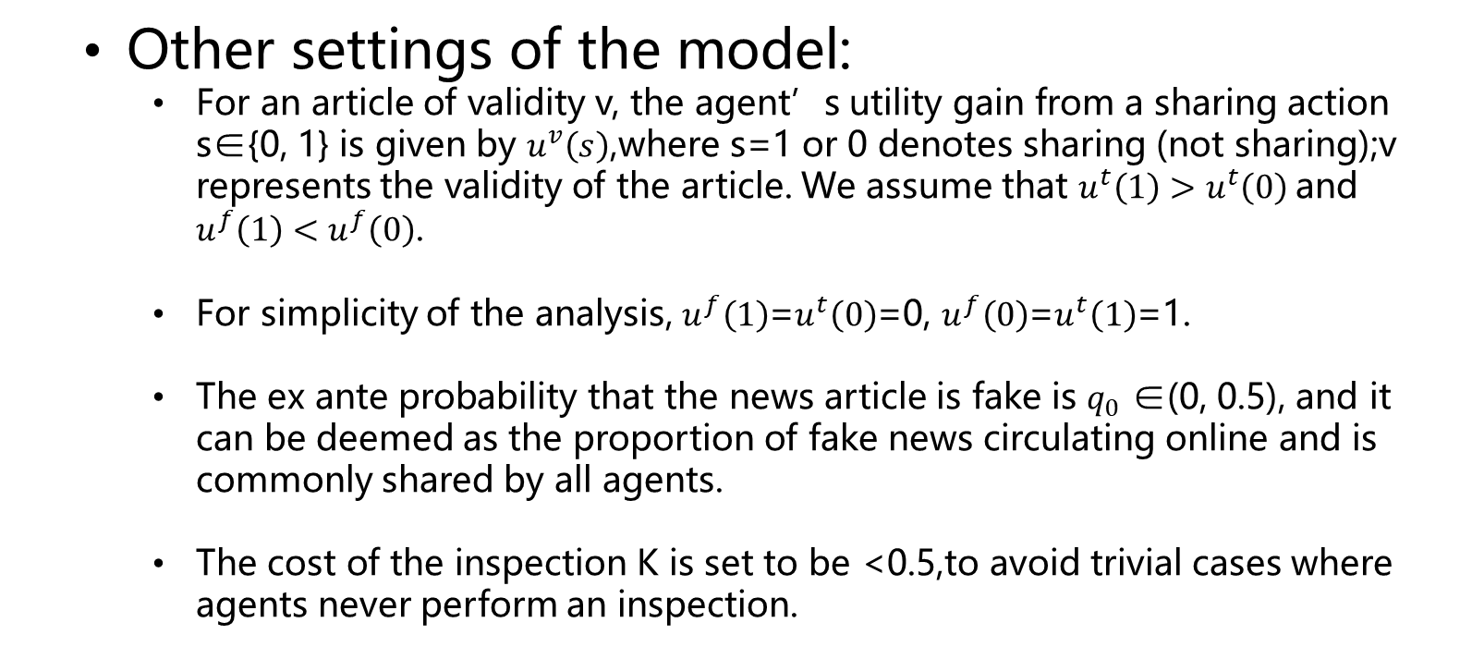
The Agents’News-Sharing Process
Other settings of the model:
For an article of validity v, the agent’s utility gain from a sharing action s∈{0, 1} is given by $u^{v}\left(s\right)$,where s=1 or 0 denotes sharing (not sharing);v represents the validity of the article. We assume that $u^{t}\left(1\right)>u^{t}\left(0\right)$and $u^{f}\left(1\right)<u^{f}\left(0\right)$.
For simplicity of the analysis, $u^{f}\left(1\right)$=$u^{t}\left(0\right)$=0, $u^{f}\left(0\right)$=$u^{t}\left(1\right)$=1.
The ex ante probability that the news article is fake is $q_{0}$ ∈(0, 0.5), and it can be deemed as the proportion of fake news circulating online and is commonly shared by all agents.
The cost of the inspection K is set to be <0.5,to avoid trivial cases where agents never perform an inspection.

Slide 18
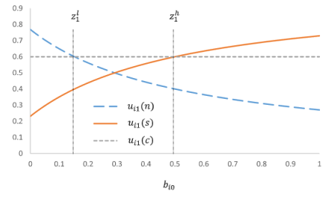
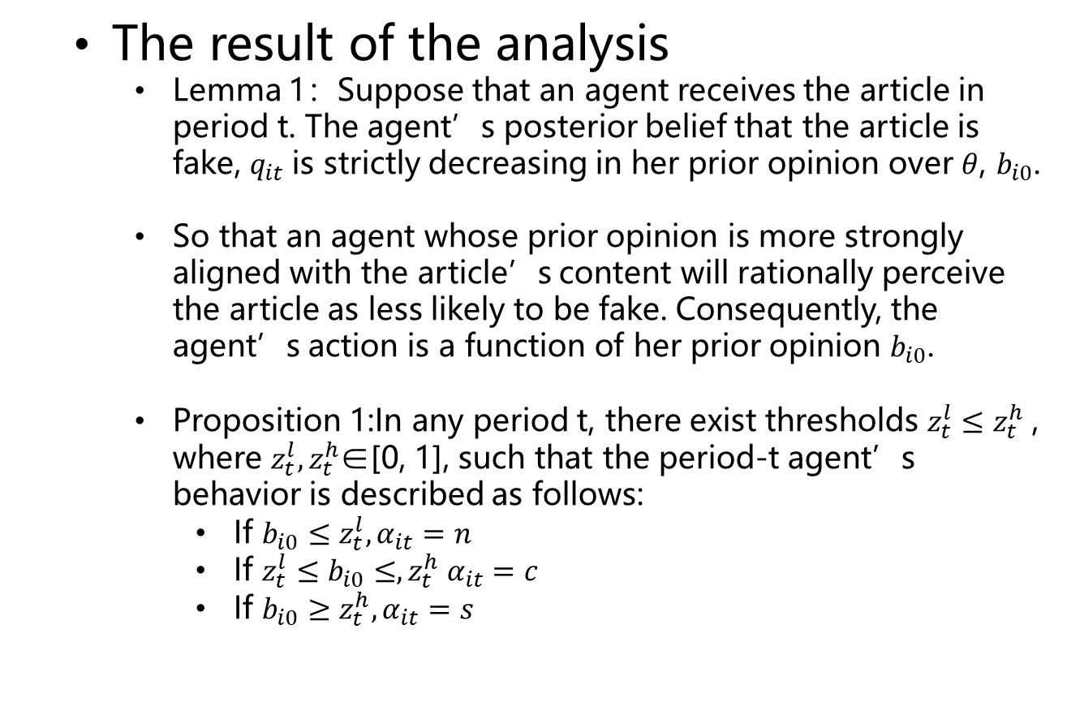
The Agents’News-Sharing Process
The result of the analysis
Lemma 1：Suppose that an agent receives the article in period t. The agent’s posterior belief that the article is fake, $q_{it}$is strictly decreasing in her prior opinion over $θ$, $b_{i0}$.
So that an agent whose prior opinion is more strongly aligned with the article’s content will rationally perceive the article as less likely to be fake. Consequently, the agent’s action is a function of her prior opinion $b_{i0}$.
Proposition 1:In any period t, there exist thresholds $z_{t}^{l}≤z_{t}^{h}$, where $z_{t}^{l},z_{t}^{h}$∈[0, 1], such that the period-t agent’s behavior is described as follows:
If $b_{i0}≤z_{t}^{l}, α_{it}=n$
If $z_{t}^{l}≤b_{i0}≤,z_{t}^{h} α_{it}=c$
If $b_{i0}≥z_{t}^{h}, α_{it}=s$

Slide 19
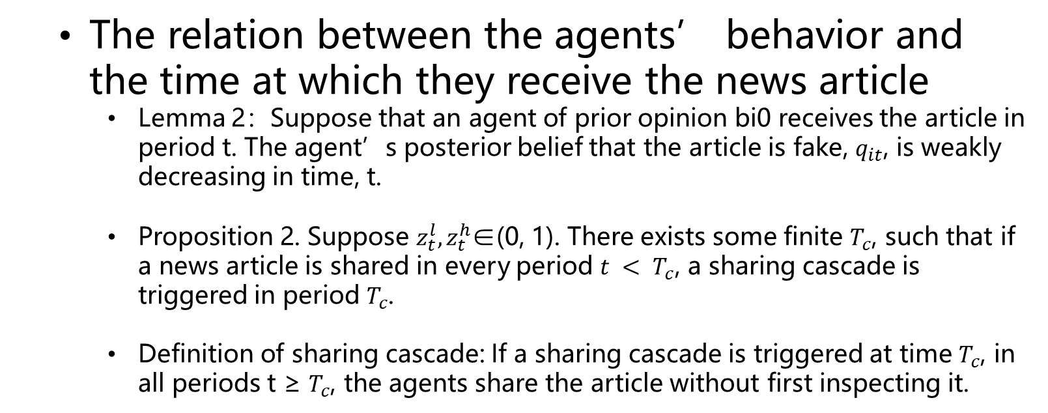
The Agents’News-Sharing Process
The relation between the agents’ behavior and the time at which they receive the news article
Lemma 2：Suppose that an agent of prior opinion bi0 receives the article in period t. The agent’s posterior belief that the article is fake, $q_{it}$, is weakly decreasing in time, t.
Proposition 2. Suppose $z_{t}^{l},z_{t}^{h}$∈(0, 1). There exists some finite $T_{c}$, such that if a news article is shared in every period $t < T_{c}$, a sharing cascade is triggered in period $T_{c}$.
Definition of sharing cascade: If a sharing cascade is triggered at time $T_{c}$, in all periods t ≥ $T_{c}$, the agents share the article without first inspecting it.

Slide 20
01
Introduction
02
Related Literature
03
Basic model description
04
The Agents’News-Sharing Process
05
The Platform’s Inspection Problem
06
The Impact of Fake News on Agent Opinions
07
Conclusion

Slide 21
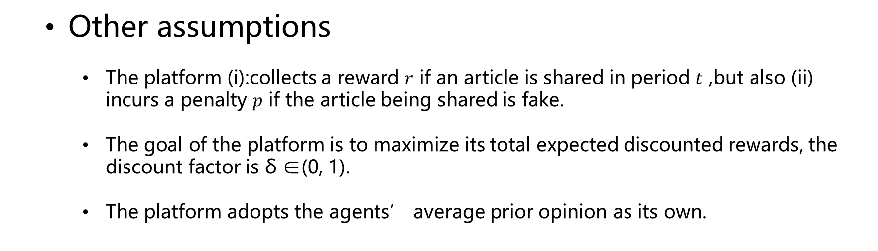
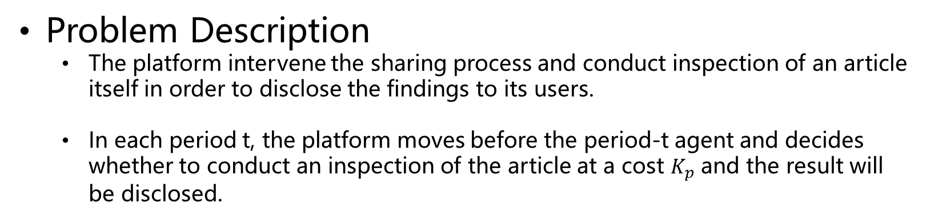
The Platform’s Inspection Problem
Problem Description
The platform intervene the sharing process and conduct inspection of an article itself in order to disclose the findings to its users.
In each period t, the platform moves before the period-t agent and decides whether to conduct an inspection of the article at a cost $K_{p}$ and the result will be disclosed.
Other assumptions
The platform (i):collects a reward $r$ if an article is shared in period $t$ ,but also (ii) incurs a penalty $p$ if the article being shared is fake.
The goal of the platform is to maximize its total expected discounted rewards, the discount factor is δ ∈(0, 1).
The platform adopts the agents’ average prior opinion as its own.

Slide 22
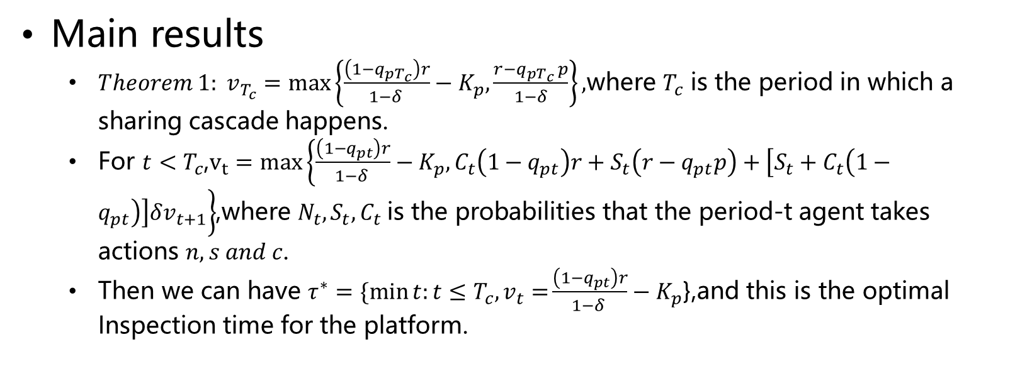
The Platform’s Inspection Problem
Main results
$Theorem 1: v_{T_{c}}=\max\left\{\frac{\left(1−q_{pT_{c}}\right)r}{1−δ }−K_{p},\frac{r−q_{pT_{c} }p}{1−δ}\right\},$where $T_{c}$ is the period in which a sharing cascade happens.
For $t<T_{c}$,$v_{t}=max\left\{\frac{\left(1−q_{pt}\right)r}{1−δ }−K_{p},C_{t}\left(1−q_{pt}\right)r+S_{t}\left(r−q_{pt}p\right)+\left[S_{t}+C_{t}\left(1−q_{pt}\right)\right]δv_{t+1}\right\}$,where ${N_{t},S}_{t},C_{t}$is the probabilities that the period-t agent takes actions $n,s and c$.
Then we can have $τ^{∗}=\{\min{t:t≤T_{c},v_{t}=}\frac{\left(1−q_{pt}\right)r}{1−δ }−K_{p}$},and this is the optimal Inspection time for the platform.

Slide 23
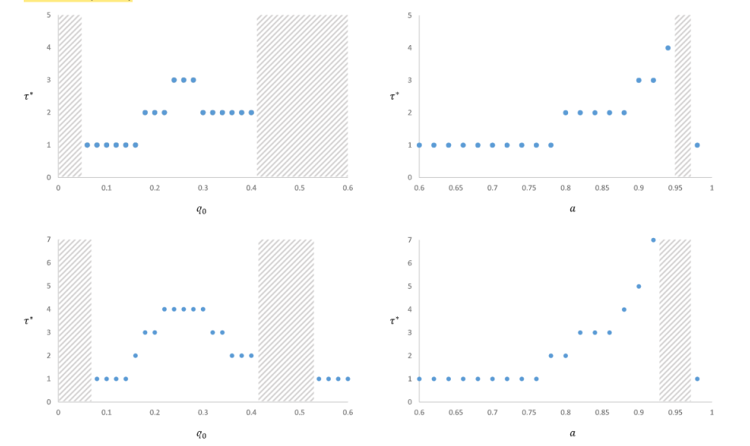
The Platform’s Inspection Problem
r=0.3
r=0.5
Note:Shaded areas reprent $τ^{∗}=∞,Parameters:K=0.3,q_{0}=0.2,a=0.85,K_{p}=3,δ=0.99,p=1$

Slide 24
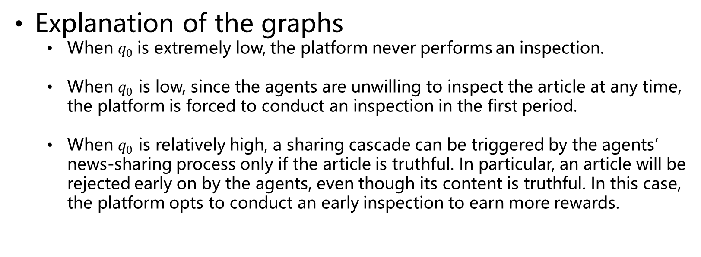
The Platform’s Inspection Problem
Explanation of the graphs
When $q_{0}$is extremely low, the platform never performs an inspection.
When $q_{0}$ is low, since the agents are unwilling to inspect the article at any time, the platform is forced to conduct an inspection in the first period.
When $q_{0}$ is relatively high, a sharing cascade can be triggered by the agents’ news-sharing process only if the article is truthful. In particular, an article will be rejected early on by the agents, even though its content is truthful. In this case, the platform opts to conduct an early inspection to earn more rewards.

Slide 25
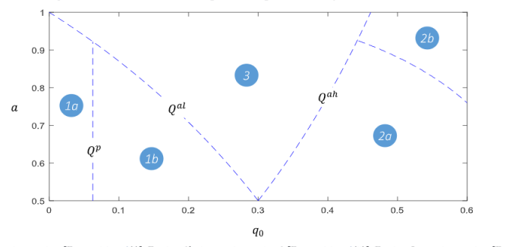
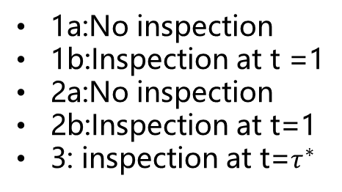
The Platform’s Inspection Problem
1a:No inspection
1b:Inspection at t =1
2a:No inspection
2b:Inspection at t=1
3: inspection at t=$τ^{∗}$

Slide 26
01
Introduction
02
Related Literature
03
Basic model description
04
The Agents’News-Sharing Process
05
The Platform’s Inspection Problem
06
The Impact of Fake News on Agent Opinions
07
Conclusion

Slide 27


The Impact of Fake News on Agent Opinions
Two types of fake articles’ effects:
Direct effects: Fake articles’content cause an erroneous shift in the agents’ opinions
Indirect effects: The presence of fake news in the news environment elevates the agents’ suspicions about the validity of truthful articles which in turn causes the impact of truthful articles to be diminished.
The expected impact of a news article

Slide 28
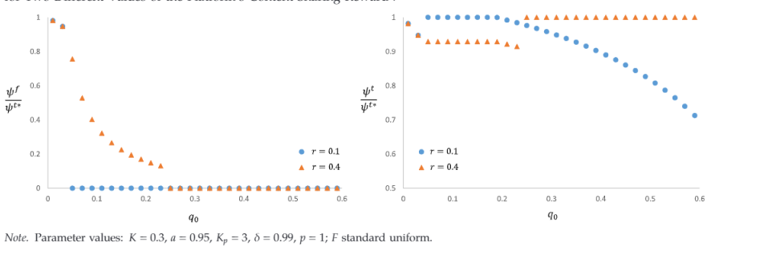
The Impact of Fake News on Agent Opinions
Fake articles
Truthful articles
Lower reward motivates the platform to ensure the impact of fake news is limited.
Higher reward motivates the platform to ensure that the impact of truthful articles is at the efficient level.

Slide 29
01
Introduction
02
Related Literature
03
Basic model description
04
The Agents’News-Sharing Process
05
The Platform’s Inspection Problem
06
The Impact of Fake News on Agent Opinions
07
Conclusion

Slide 30
Conclusion
Contribution
Agents are rationally more likely to share an article the more it has been previously shared by their peers, resulting in fake news articles going viral after receiving a sufficiently high number of shares.
Agents of different prior opinions are likely to differ in their inspect-and-share actions in predictable ways.
When ex ante probability that an article is fake is very low, the platform should not conduct an inspection; when it is moderately low, the platform should conduct an inspection from the onset of the sharing process; when it is moderate, the platform should conduct a delayed inspection; and when it is high, the platform should either conduct an inspection from the onset or no inspection at all.
Penalties are not always effective in motivating the platform to safeguard its users.

Slide 31
Conclusion
Deficiency
Assume the fake news is generated exogenously and ignore the generating process of the fake news in reality.

Slide 32
Thanks for watching

